Slide 1
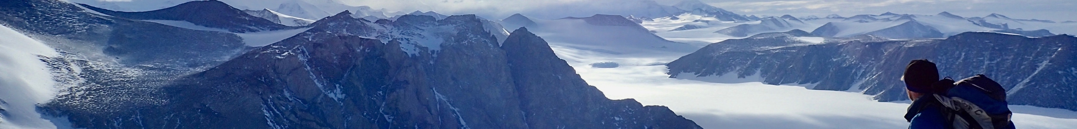
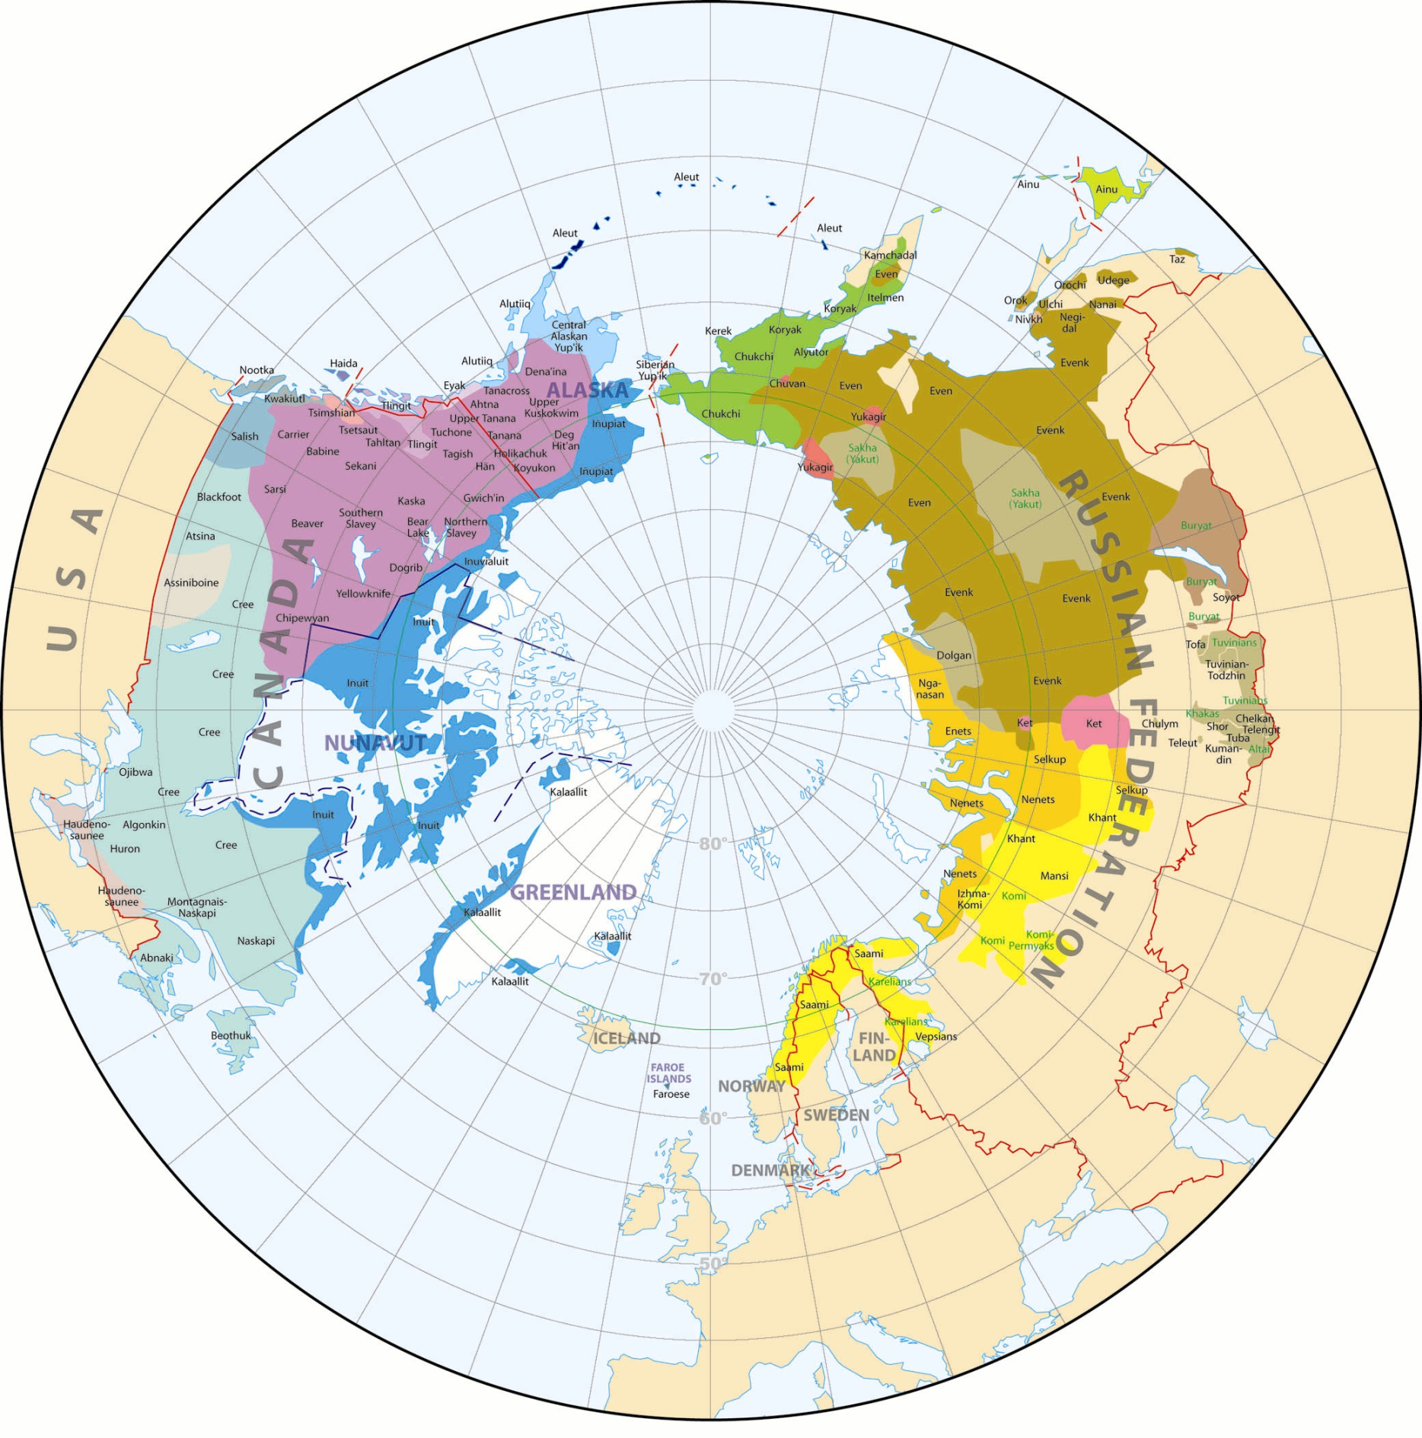
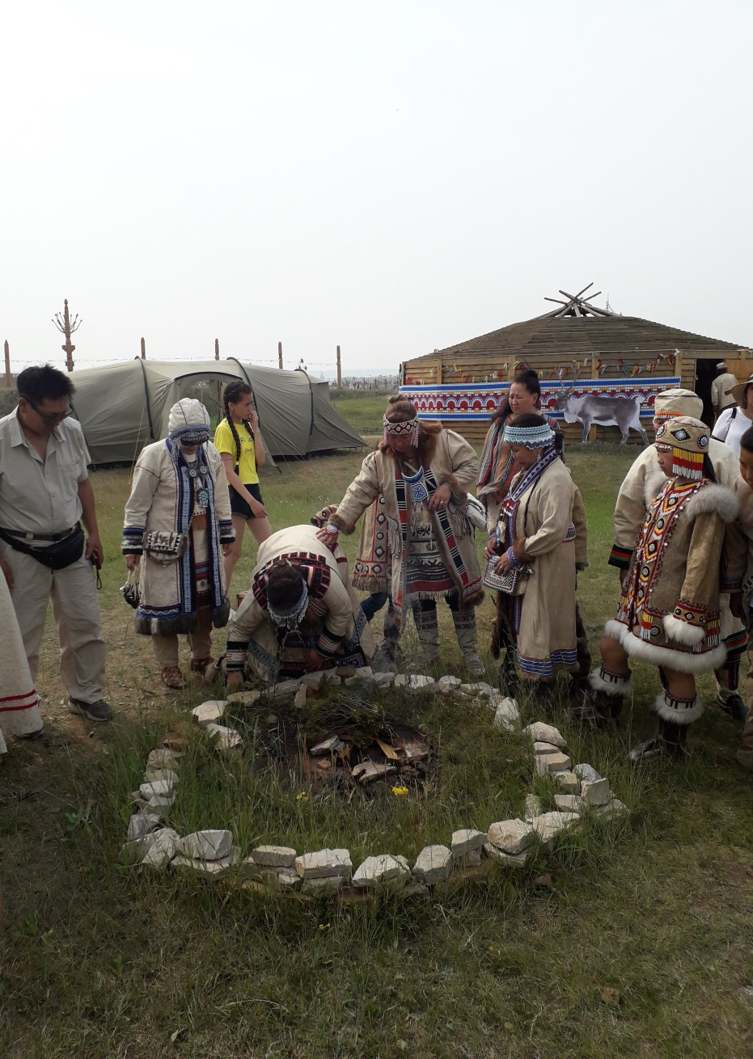
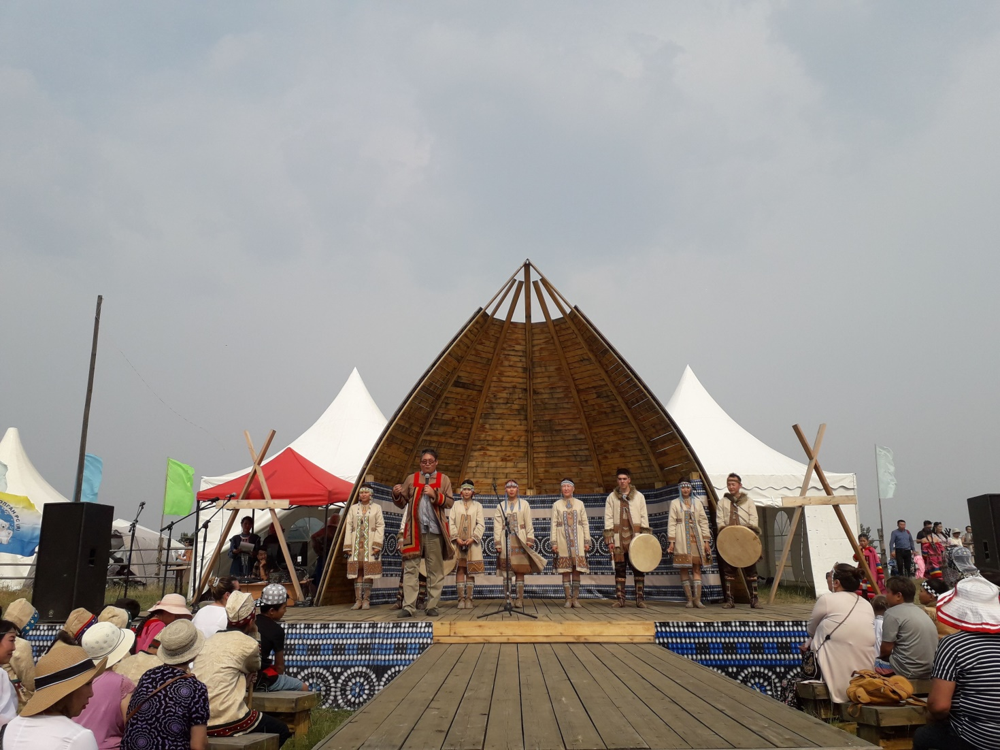
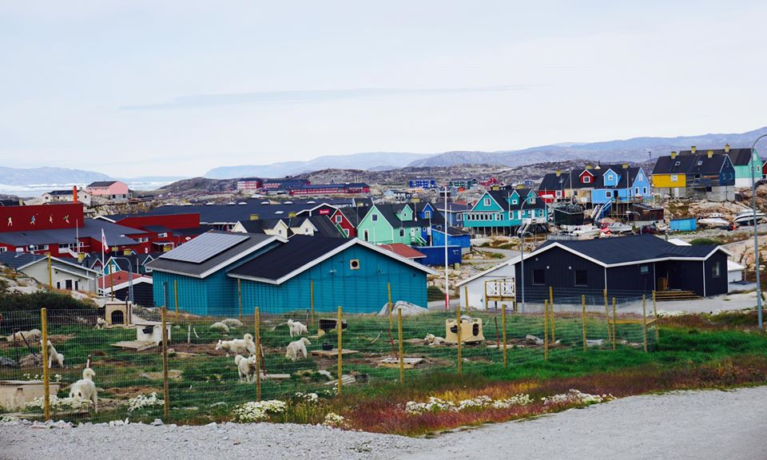
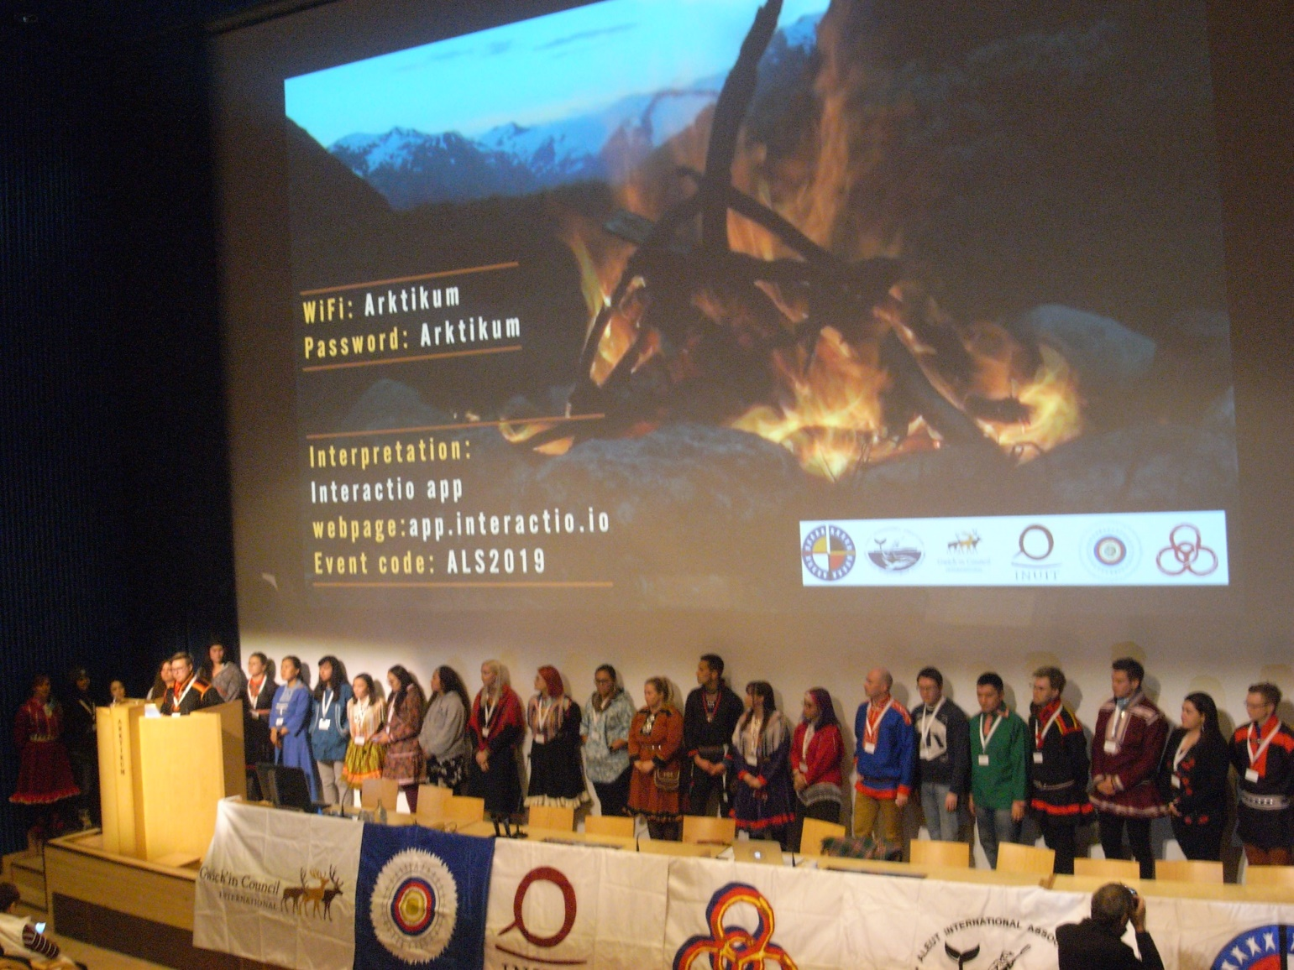
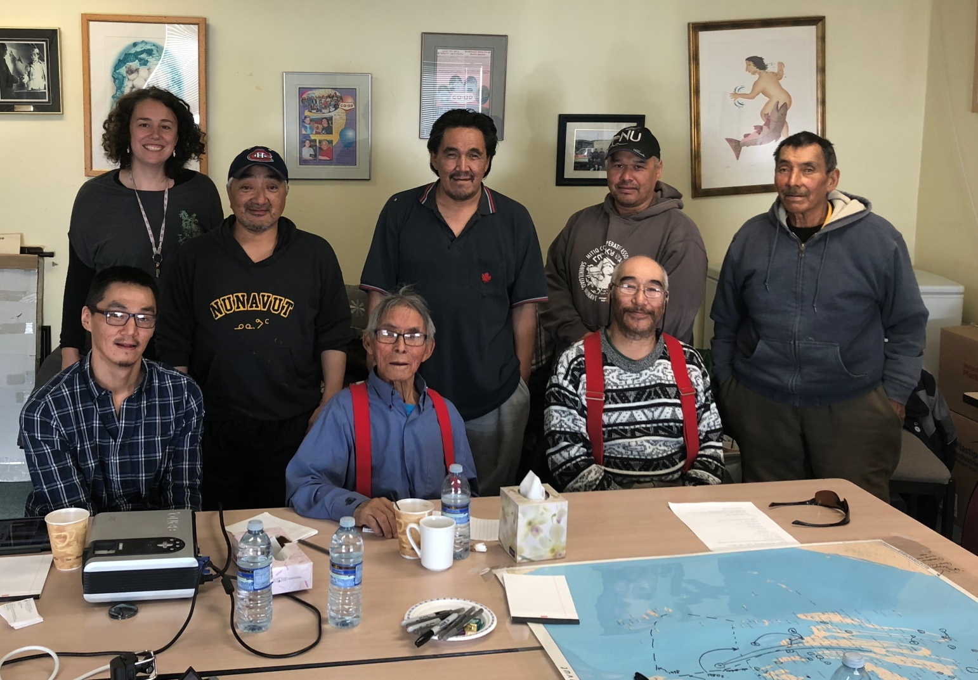




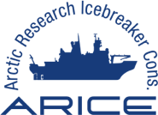




International Polar Week 2020:
Indigenous Collaborations
Geographical distribution
Approximately one million people, or 9% of the total population in the Arctic is of indigenous heritage (Source: Nordregio)
Arctic indigenous peoples include, for example, Saami in Circumpolar areas of Finland, Sweden, Norway and Northwest Russia, Nenets, Khanty, Evenk and Chukchi in Siberia, Aleut, Yupik and Inuit (Iñupiat) in Alaska, Inuit (Inuvialuit) in Canada and Inuit (Kalaallit) in Greenland. (Source: Arctic Centre)
info@apecs.is
www.apecs.is
indigenous-collaborations@apecs.is
Left to right: Fire ceremony, Yakutsk, Russia (S.Ksenofontov); Evenki dance performance, Yakutsk, Russia (S.Ksenofontov); Ilulissat, Greenland (V.Buschman)
Indigenous peoples distribution in the Arctic (Map compiled by Norwegian Polar Institute)
Collaborations between scientists and Indigenous people
Collaboration goals
Our group aims to build close partnerships with the Arctic indigenous organizations in order to get involved in each others activities and thus mutually benefit from each other.
In doing so, we seek to:
Form partnerships with indigenous organizations that could help to set the priorities of the group;
Find mutual interests of future partnerships for shared benefits;
Design better strategies for building relationships with indigenous communities (to avoid complicated situations for/with researchers and individuals in the community);
Recruit young people and early career scientists (ECS) interested in becoming involved in the project group to guide Council members towards actions that would fulfill our partnership agreement and benefit indigenous communities as well as our membership;
Develope a guide on how to promote community-collaborative research projects, highlighting examples of success stories, as well as integrating events which give a voice to indigenous communities into our International Polar Weeks
In order to better involve indigenous organizations in scientific activities, share knowledge and experiences about field of studies/collaborations/contacts, scientists always try to establish project group on indigenous partnership.
Indigenous Youth at the Arctic Leaders Summit in
Roveniemi, Finland, 2019. Photo by S.Ksenofontov
Indigenous Hunters Workshop, Canada. Photo by M.Sheremata
What is APECS?
Projects
Get Involved in APECS!
The Association of Polar Early Career Scientists (APECS) is an international and interdisciplinary organization for students, postdoctoral researchers, early faculty, early career professionals, educators and others with interest in the Polar and Alpine regions and the wider Cryosphere. It aims to:
Create a network of polar researcher
Provide the opportunity for career development
Promote education and outreach
APECS celebrated its 10th anniversary in 2017. The current membership number in July 2019 is about 2873* from 70 countries.
*Due to a complete restart of our membership list in May 2018 to comply with the new General Data Protection Regulation in the European Union
APECS, at times, is involved in larger projects responsible for their training and outreach activities. Since 2016, and in cooperation with its hosting institutions, APECS has been a partner in four EU Horizon 2020-funded projects of the EU Arctic Cluster:
APPLICATE - Advanced Prediction in Polar regions and beyond: modelling, observing system design and LInkages associated with a Changing Arctic ClimaTE
INTERACT - International Network for Terrestrial Research and Monitoring in the Arctic
ARICE - Arctic Research Icebreaker Consortium
Nunataryuk
APECS is proof that a community-driven effort can become a robust professional organization in just a few short years. By working with senior scientists and other mentors, APECS members’ enthusiasm has successfully been harnessed in the APECS we see today. You can be part of it!
Attend an APECS Webinar
Organize or attend a Pane or Workshop
Join the APECS Council or Executive Committee
Join an APECS Project group or create one!
Get involved in one of our National Committees (or create your own if your country doesn’t have one yet!)
Post jobs, events and articles to www.apecs.is
@Polar_Research
facebook.com/apecs4u
vimeo.com/apecs
APECS International Directorate Office
Alfred Wegener Institute
Helmholtz Center for Polar and Marine Research
Telegrafenberg A45
14473 Potsdam, Germany

