Slide 1
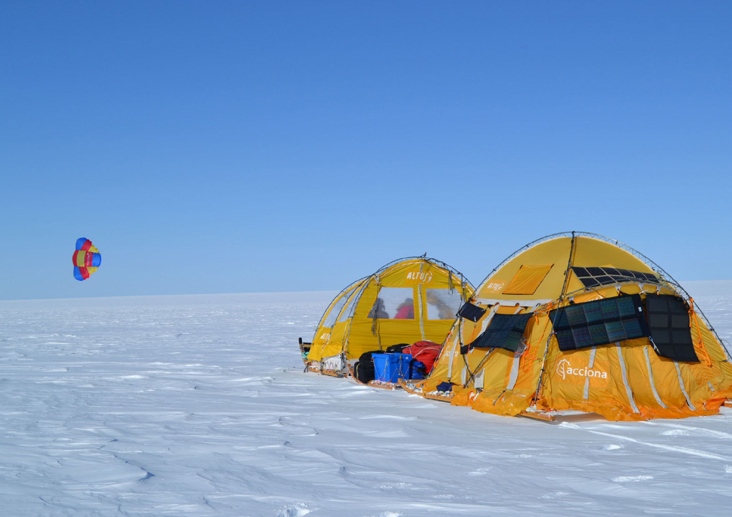
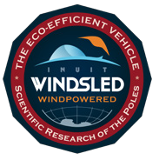
THE INUIT WINDSLED PROJECT
ANTARCTICA WINDSLED CIRCUMNAVIGATION 2018-2019
GREEN REVOLUTION IN ANTARCTIC RESEARCH
RAMÓN H. LARRAMENDI

Slide 2
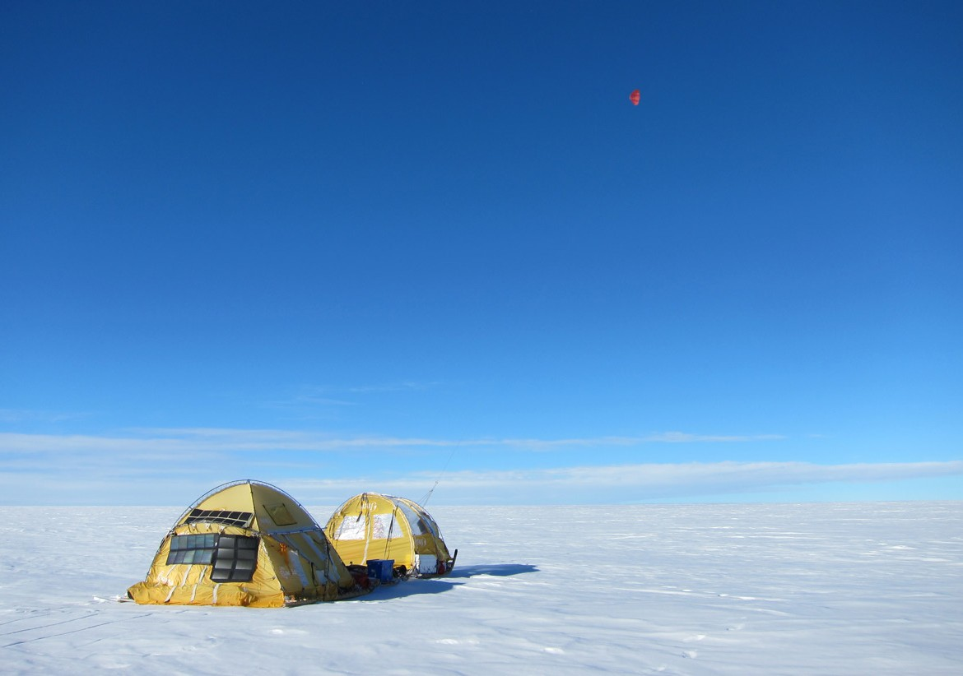
Resume.
The concept.
The Background.
The achievements. 2000-2016
Dark snow Greenland Ice Sheet Circumnavigation 2018.
Why Antarctica Windsled Circumnavigation 2018-19.
Windsled models used.
Route Transects Descriptions.
The Scientific Projects.
The Expedition aftermath.
About Ramon Larramendi.
The Team.

Slide 3
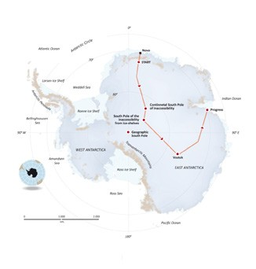
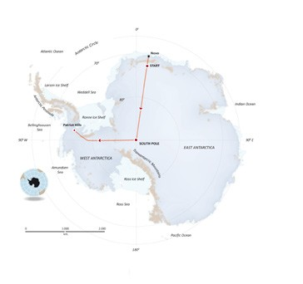
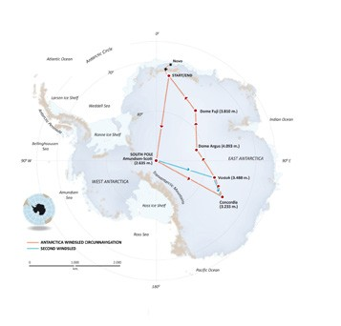
RESUME
Juanma Viu , Ignacio Oficialdegui and Ramon Larramendi crossed Antarctica using a windpowered vehicle for the first time in history in 2005-6. After that expedition they came up with
one question. ¿Is it possible to develop and use efficiently a windpowered vehicle in order to set a new standard of scientific land traverses in Antarctica totally clean?
The answer is yes. And this is what Ramon and his team want to prove with the ANTARCTICA WINDSLED CIRCUMNAVIGATION
2017-18. To realise an unprecedented journey of 7500km, with a new concept of vehicle designed for scientific research. The Inuit Windsled. A vehicle Inspired in the past that will drive us to a clean future.
2005 / 2006 WindSled Expedition
2011 / 2012 WindSled Expedition 2017 / 2018 WindSled Circumnavigation

Slide 4
THE CONCEPT

Slide 5
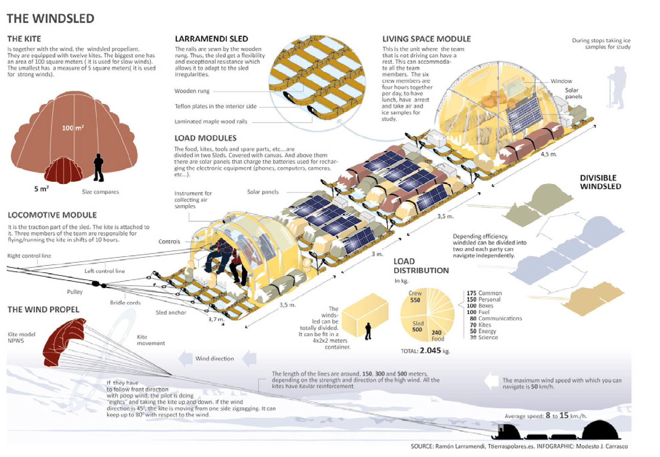

Slide 6
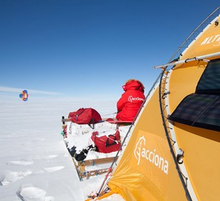
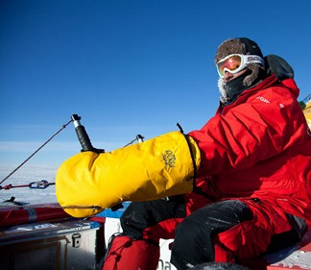
The WindSled
The WINDSLED is a vehicle inspired on ancient Inuit sled, it consists of a convoy of speciallly designed sleds (Larramendi Sled), with lightweight tents on top of it for
living and working, being the whole system powered by giant kites up to 100 square meters located some 300 meters from the sled.
wide and long as it is needed. Made of carbon fiber, glass fiber, polyethylene and wood.
The WINDSLED shall consist of different numbers of Larramendi Sleds from 1 to 4, with a maximum length of 14 meters and a width of almost 4 m. Each sled is made up of 6 runners attached to each other with light crossbars.
This principle has been conceived, developed and tested by Ramon Larramendi and his team over 17 years. But this is the first time that is adapted to fit as a pure scientific vehicle in Antarctica. The WINDSLED can load up to 2-2,5 tons of cargo, have the capacity to carry 6 people and be able to cover distances of between 50 and 150 km/day. This allows access to very remote areas, which requires an enormously complex and expensive logistic to reach.
The full set is composed of 24 sled runners and 350 crossbars. Weighing 500 kilos. A big windsled can be divided into 2 or 3 windsleds doing parallel or different routes. The sled
is very easy to repair in case of break up, and is foldable in smaller pieces what is vital
for transportation in the small planes of Antarctica, Twin-Otter and Bassler.
Larramendi Sled is an adaptation of Inuit sled concept, that allows to build sleds as

Slide 7
It means a full new way of transportation, complementary to the existing ones but with some very strong advantages compared to any other system of land transport.
Inuit sleds, making it extremely flexible, allowing to overcome with astonishing easeness, fields of giant sastrugi. It’s design is oriented to navigate the most difficult regions. The technique has been tested in 2 previous Antarctic traverses and 8.000 km have already been logged over the Antarctic plateau.
7-Safety. Finally, the system is very safe, after 20.000 km logged over Greenland and Antarctica through its development, it has not been involved in any accident, incident or serious risk. Of course their management must be performed by skilled personel like any other means of transport.
1-Zero-emissions. The WINDSLED is the first and only totally clean vehicle capable of moving efficiently through the interior of Antarctica.
For all these reasons we believe the WINDSLED is a real alternative and an excellent complement to existing systems of transport, research and data sampling.
5-Reliability. The system is extremely simple, everything can be easily repaired on the field. The simplicity connects the Inuit concept with high technology to achieve lighter and better benefits. It is the power of simplicity.
2-Low cost. The simplicity of the sled makes it have a very low cost and a big durability, coupled with the ease of logistical resources needed from origin, make this option by
far the most economical way to conduct research within Antarctica.
6- Efficiency. The WINDSLED is also very efficient, as demonstrated in the expedition Acciona Windpowered Antarctica 2011. The WINDSLED was able to travel 3.500 km in 34 days. Performing an average of nearly 100 km/day. Its payload capacity is aproximately 2 tons.
-Logistical simplicity. The entire sled is removable and lightweight. It is designed to fit inside a Bassler airplane, mostly used in the interior of East Antarctica, making very feasible to relocate and collect from any point of the continent.
4- Adaptability. The sled is inspired by

Slide 8
BACKGROUND

Slide 9
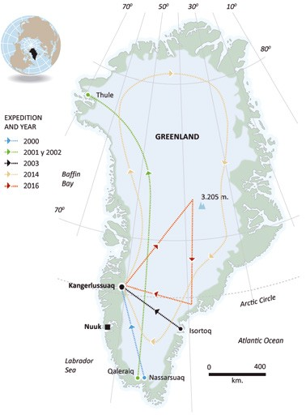
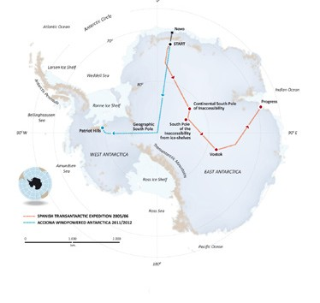
Sailing over the ice with an sled the same way is done in the sea in a sailing boat is an old dream of polar exploration.
Nansen, Amundsen, Scott, Peary all of them used sails placed over their sleds in order to lighten the weight while they or their dogs pulled.
Along the 20th Century several people tried to use the wind in the ice caps of Greenland and Antarctica of different ways. Mostly skiing with the help of kites. But in 1999 when Ramon studied the idea for the first time. No one had managed
to sail with an sled over the big icecaps moved by the wind as in a sailing sled.
Ramon first got the idea of sailing over the ice while skiing from Siberia to the North Pole in March 1999.
Inspired in his extensive arctic experience
and deep knowledge of Inuit philosophy and technique, he
had traveled 14000 km by dogsled from Greenland to Alaska
between 1990 and 1993. (See the article “Perilous Journey” · National Geographic Magazine January 1995).
GREENLAND
WINDSLED SUCCESSFULLY FINISHED EXPEDITIONS
ANTARCTICA
WINDSLED SUCCESSFULLY
FINISHED EXPEDITIONS

Slide 10
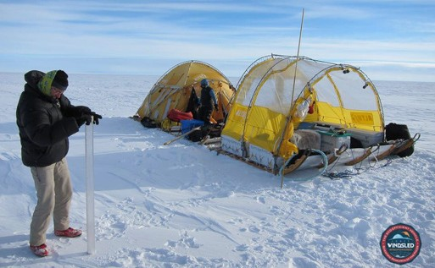
For January 2000 the design and concept was then clear, mixing Inuit wisdom and tradition with High technology. A big sled built upon the Inuit concept of Wood and slashed of special way would made a big, flexible and light sled, easy to fix, it would be pulled by giant Kites, and on top of it a fix tent would be the protection to the elements making an strange looking but effective sailing sled.
much more eficiently and with heavier loads tan before.
In 2014, a new successful expedition took place in Greenland, where the windsled team circumnavigated the island, covering 4300 km with a heavier more sophisticated sled.
In 2016 a new expedition was carried out with a more sophisticated windsled, transporting 2000 kg, carrying 6 passengers, and covering 2000 km around the Greenland icecap, including the ascent to the scientific base SUMMIT, carrying out 3 scientific projects for Spanish universities and for Dr Jason Box of GEUS (geological survey of Denmark.)
4 expeditions across greenland in 2000, 2001, 2002 and 2003 including 2 south-north journeys served to test the feasibility of the idea and the efficiency of the concept, all expeditions were succesful, 6000km were covered altogether showing the huge potential of the Inuit windsled concept as the first sailing boat for the ice.
All that was a preparation for the first crossing of Antarctica in a windpowered vehicle. The challenge was carried out succesfully in 2005-6. Crossing East Antarctica via Pole of Inaccesibility reaching the region for the first time since the 1960, s. 4500km were sailed sucesfully in 62 days. There was technical dificulties but the potential of the concept was again demostrated.
In 2011-12 a new succesfull crossing of Antarctica was undertaken, introducing many innovations. 3500km were sailed in 34 days.
Reaching for the first time in windsled the south pole. And sailimg

Slide 11
INUIT WINDSLED PROJECT
Achievements 2000-2016

Slide 12
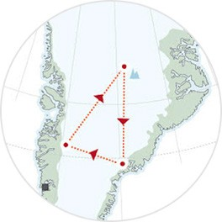
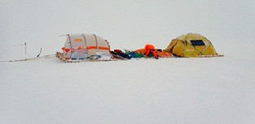
The name Inuit Windsled Project refers to all the developments made since 1999. The AWC 17-18 is simply the culmination of that project, and cannot be understood without the background.
1100kg. For the first time working day and night in a rotation system, proving sleeping in the move was possible. Covering 3500km in 34 days.
Nevertheless, all that has been just a preparation for the present Project, the culmination of 17 years work, and the start of a new step in polar travel.
In 2014 Greenland circumnavigation, the efficiency of the concept was greatly improved, as we travelled 4300kg with
an 1500kg sled, 9 meter long, working in a convoy of 3 sleds, capable of transporting 5 passengers. Rotations being more eficient. Opening definitively the way to still heavier and more efficients sleds.
In January 2000 for the first time an sled was moved by the wind for 2km in Lac des Bouillouses in the French Pyrenees.
Between 2000-2003 we proved the concept simply works covering more than 6000km in 4 Greenland ice cap crossings.
In 2005 / 2006 we proved for the first time ever it was posible to sail across the interior of Antarctica onboard a light 5,2m sled, transporting 3 persons and carrying 750kg. Covering 4500km in 62 days.
In 2016 Greenland Summit expedition 2000km were travelled with a more sophisticated windsled, made up of 4 sleds, 12 meter long, transporting 2000 kg, carrying 6 passengers, proving that a scientific convoy made up with windsled is not a dream but a reality.
In 2011 we proved it was posible to sail fast and eficiently across Antarctica, with a longer sled, 7,5m long, working as a convoy for the first time, and transporting 4 persons and
Surprisingly so far no other team in the world is working in that concept or idea.
Greenland Summit Circumnavigation Expedition 2016

Slide 13
GREENLAND WINDSLED CIRCUMNAVIGATION 2018
The Dark Snow Greenland Ice Sheet

Slide 14
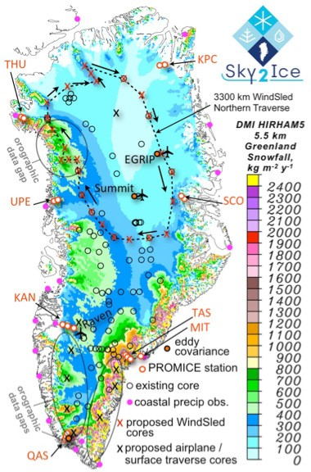
Will be the first 100% scientific expedition ever conducted with windsled, planning to circumnavigate North Greenland ice cap while coring down to 20-25 meters and analyzing that information on the ice, the scientific project will be lead by PhD Jason Box.
20 expeditions to Greenland since 1994, was for five consecutive years (2008-2012) the lead author of the Greenland section of NOAA annual State of the Climate report, was a contributing author to the IPCC AR4 and has authored more than 60 peer- reviewed publications focused on ice climate interactions. He has led the Dark Snow Project.
It will last for 60 days in the months of May-June 2018, This project will open Windsled use for research in the arctic. What AWC 18-19 wants to do is exactly the same but in the Antarctic.
This expedition will help to further develop the Windsled techniques, and will be an excellenty preparation for AWC 18-19.
Jason Eric Box, PhD is professor in glaciology at the Geological Survey of Denmark and Greenland for 10 years. (2002-2012). He has made more than

Slide 15
WHY ANTARCTICA
WindSled Circumnavigation 2018-2019

Slide 16
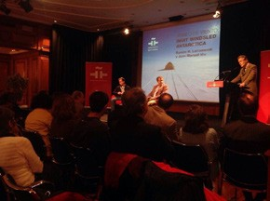
Circumnavigating Antarctica with Windsled, is a huge geographical, scientific and
conceptual challenge. The technology in itself involved is very simple, while the concept is totally revolutionary, precisely because of its incredible simplicity.
starting from the best connected and easiest access area to interior Antarctica, that is Novo Airport.
Our intention is that the expedition is the foundation of a future scientific windsled network, and the experience and the route opening between bases will be vital for further developments in the future.
The goal of the expedition is to prove with facts the potential of Windsled as a transportation and research vehicle in
Antarctica, we believe windsled can have an important role in the 21st century data gathering in Interior Antarctica, as it will allow a new type of land traverses totally different to the concepts now existing, light, clean and inexpensive.
At the same time we will test different concepts of Windsled, changing the capacity, the lenghth, the payload, the purpose, because Windsled is not something fix but rather a very versatile concept, there are four different options of Windsled, each one with different potentialities, and we plan to prove all of them. Including the fact of dividing it and make 2 simultaneous traverses with different goals.
Any possible future use of windsled will be linked to the heavier logistics and bases existing in its interior, for that reason the route chosen will connect all scientific bases and camps existing in the interior of Antarctica, South Pole, Concordia, Vostok, Dome Argus (Kunlun), Dome Fuji. And

Slide 17
THE ROUTE
and the different Windsled models used

Slide 18
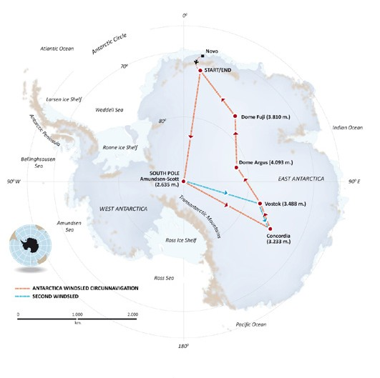
Two different complementary separate routes will be done each one involving different number of people, sleds and cargo.
ROUTE 1: Circumnavigation of Antarctica.
Estimated Distance: 7500 km.
Departure Europe. October 30. Flight to Novo. November 4. Start. November 6, 2017
Estimated pick up from same place .February 20, 2019. To Europe, February, 26. 2019.
A total of 105 days traverse, carried out by 4 persons.
ROUTE 2: South Pole-Vostok-Concordia.
In a parallel windsled. Estimated Distance: 2000 km
Estimated Departure Europe. 25 November. Departure South Pole. December 5.2018
Estimated Arrival to Concordia. January 25. To Europe. Late February. 2019.

Slide 19
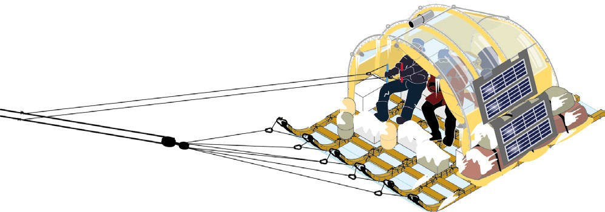
The reason for that is that we will test all 4 different configurations of windsled for 4 different requirements and needs, we will call them:
THE LIGHT WINDSLED
Is the lightest and smallest version possible of Windsled Expedition. Can be made of one simple tractor vehicle. Has very little transporting capacity. Sizes. 3,6m long x 3,5m long.
Weight of the sled. 100 kg. Number of people on board. 2-3. Payload. 600 kg.
Autonomy. Max. 2000 km.
expeditions needing a very basic or light scientific equipment, will be ideal solutions, as would be cheapest and lightest way to link any of the bases in the plateau.
Testing will happen in the first section of the trip from Novo to South Pole. This is the model that was
used successfully in Spanish Trans Antarctic Expedition 2005-6.
Advantages. The lightest and most basic sled can be one of the most practical configurations, as for

Slide 20
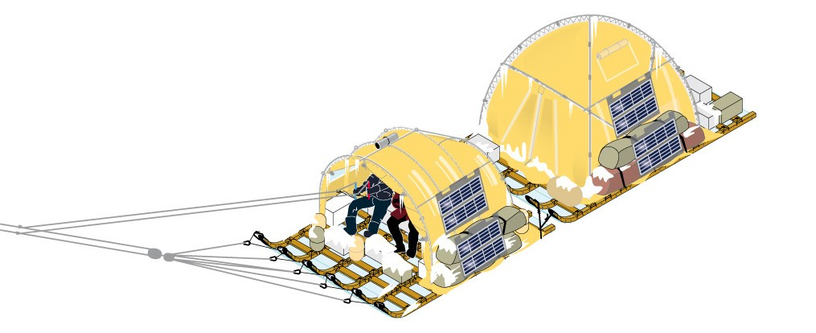
THE LONG DISTANCE WINDSLED
Is the most efficient configuration of windsled. Capable of travelling enormous distances in Autonomy. Made up of a convoy made of 2 sleds
Sizes. First sled. 3,5m x 3,6m. Second sled. 4,5m x 3,6m sled. Weight of the sled. 230 kg.
Autonomy. 7500 kg.
Advantages. Is the most efficient configuration, ideal for very long or very fast traverses, with a moderate capacity of extra Cargo. (50-100 kg).
This option was tested in 2011 crossing of Antarctica with big success. As 3500km were covered in 34 days, That will be the configuration that the AWC 17-18 will adopt from the South Pole to the end of the route.
Number of passengers. 3, 4. With 3 passengers is not most efficient in long distance, but has more capacity to transport extra weight. With 4 passengers is possible to make rotations driving as many as 20 hours a day into 2 persons shifts.
Payload. 1400. Kg.

Slide 21
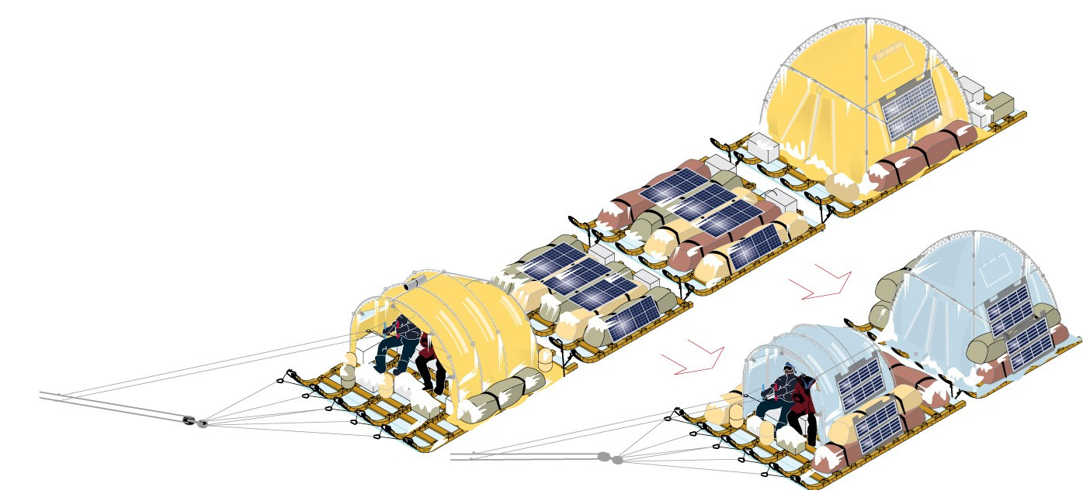
THE BIG WINDSLED
Is called big, but indeed its versatility is its strength, as is the configuration of a convoy made up of 4 sleds in train. Sizes. 3,5m, 3m, 3m and 4,5m totaling 14 meters long.
Weight. 500 kg.
Payload. 2500 kg.
Autonomy. 2000 km.
Number of passengers. 6. The sled will move in 2 rotations, and is the best for the most sophisticated work, and heavier scientific equipment. Is the most complete configuration as it allows to recreate the rest of all the options.
Advantages. Specially fit for an expedition that can need different sleds work in parallel for some distance, as can
be separated and reunited afterwards. Also is optimal for the transport and use of heavy scientific equipment into a not very long distance.
This concept has been tested in the Greenland Summit Expedition 2016, and in the expedition will be tested in the first leg of the traverse. Novo-South Pole.

Slide 22
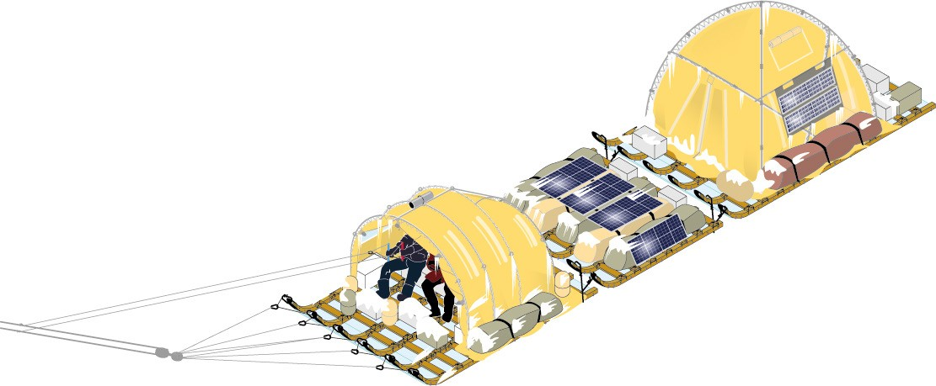
THE HEAVY WINDSLED
Is the optimal configuration for the heaviest scientific expedition that can be done as it gets its biggest capacity. Is not so versatile, but could transport between 300 and 400 kg of scientific equipment.
Sizes. 3,5m, 3m, 4,5m. In total 11m. Weight. 400 kg.
Payload. 2000 kg.
Autonomy. 2-3000 kg.
Number of passengers. 5. In order to make the rotation system. Having 3 drivers and 2 scientists. That way, the sled is moved during the night, and during the day scientists can work each day in a different spot. While drivers rest.
Advantages. Minimum weight of sled and people, with biggest scientific capabilities, while maintaining a moderate size and weight. This concept was tested in Greenland Circumnavigation 2014. And will be tested in the secondary route from South Pole to Vostok and to Concordia., that is intended to carry out more sophisticated and heavier scientific work than the rest of the route.

Slide 23
THE ROUTE
Transects Descriptions

Slide 24
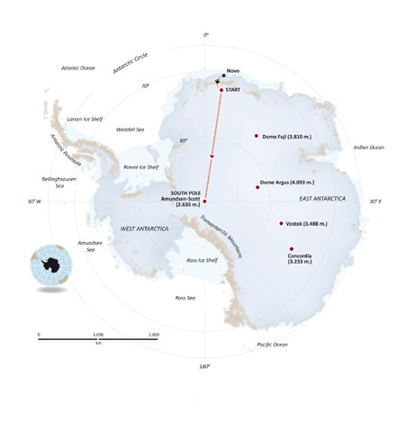
NOVO > SOUTH POLE
Estimated flight onto ice cap. 72ºS. – November, 7, 2018. Estimated arrival to the South Pole. December 3, 2018. Distance. 2000 to 2200 km.
Estimated time. 25-27 days.
Configuration. Start first week with long distance windsled, in 2 teams of 3 people each. As conditions will be too cold during night and rotation system will not be advisable. During the second week will change to Light and Heavy windsleds, for finishing in the third and fourth week with the big Windsled, with 6 passengers.
Testing therefore all possible options .
In that first part of the trip the sled will transport a total weight of 2100 kg and will carry out light science, meaning sampling that not require very heavy equipment, and not require too long time.,
This leg of the trip has already been done with Windsled in ACCIONA WINDPOWERED ANTARCTICA 2011. With a long distance windsled, in just 18 days.

Slide 25
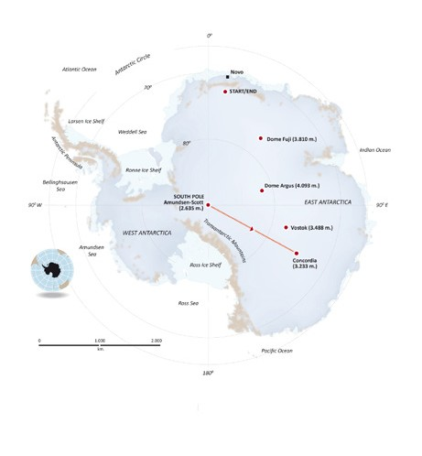
SOUTH POLE > CONCORDIA
Estimated Departure from south Pole. December 6, 2018.
Estimated arrival to Concordia. December 25, 2018.
Distance and Time. 1700-1800 km in 20 days.
With a long distance, 2 modules windsled, and 4 passengers carrying out light science.
This leg has never been done with Windsled.
Wind is expected to be favourable, and weather is expected to be optimal for travelling.

Slide 26

CONCORDIA > DOME ARGUS
Estimated departure from Concordia. December 28, 2018
Estimated arrival to Dome Argus. January 16th, 2019.
Distance and Time. 1600-1800 km in 20 days.
Long distance windsled, with 4 people, doing light science.
Weather conditions should be still optimal, referent to light, coldness and instability.
The first goal will be to reach Vostok station, what seems very difficult to achieve, the distance is of some 600 km, and the wind adverse, but testing the possibility of opening a link between Vostok and Dome C is a priority.
Nevertheless the most likely option is that a not straight line has to be adopted, not reaching Vostok, but passing through a position some100 to 200 km south of it.
To reach Dome Argus or Chinese Kunlun station is another major challenge, that we estimate will be difficult, but possible. The experience ascending to Summit 3240mts in Greenland has shown us that is possible tosail to highest position in a polar plateau.

Slide 27

DOME ARGUS > NOVO
Estimated departure from Dome Argus. January 19, 2019.
Estimated arrival to Start position. February 19, 2019.
Distance and time. 2000 km in 30 days.
Long distance windsled with 4 people and light science.
Weather conditions are expected to be difficult as fall is coming by, while night will be colder and darker, and overall conditions will be much more challenging, to counterweight the team will be at its best in experience and skill.
Ascent to Dome Fuji seems possible studying wind patterns, and overall wind sistes seem favourable.

Slide 28

SOUTH POLE > VOSTOK > CONCORDIA
The team of the Vostok Traverse will be made up of 2 people coming from Novo, and 3 people flying to the south pole, 1 member of the windsled team and ideally 2 scientists.
Estimated departure from south pole. December 6, 2018.
Estimated arrival to Vostok. January 6, 2019.
Departure from Vostok. January 9, 2019.
Arrival to Concordia. January 26, 2019.
This transect will take place parallel to the Antarctica Windsled Circumnavigation. A Heavy Windsled with 5 persons on board, carrying a total weight of 2000kg and doing heavy science, meaning transporting up to 300 kg of scientific equipment for coring down to 20m.
This transect will allow the project to test the potential of heavier scientific work in Antarctica, based on the works and experiences carried out on Dark snow Greenland Ice Sheet Circumnavigation 2018.
At the same time will allow us to open the route to Vostok, and from Vostok to Concordia.
Wind and general conditions are expected to be favourable.
The possible scientists and the scientific project are not yet determined, even if a continuation of 20m Coring work started in Greenland seem the ideal option.

Slide 29
THE SCIENTIFIC PROJECTS

Slide 30
GREENLAND CIRCUMNAVIGATION 2018. Dark
Snow Greenland Ice sheet circumnavigation, Dr. Jason Box.
ANTARCTICA WINDSLED CIRCUMNAVIGATION
will carry several light science projects. Understanding by light science, data sampling that has not big requirements in terms of weight of the systems, and in working time in the field, and that therefore can be compatible with a long distance traverse as the AWC 18-19.
“Understanding the succession of Antarctic Microbial Comunities from deglaciated soils using new methods for big data”
MICROAIRPOLAR. Led by Dr. Antonio Quesada and Dra Ana Justel. This project include the taking of air samples along all the way has been pre-aproved for funding by Spanish Antarctic Programme.
Antonio Quesada. Professor in the Universidad Autónoma de Madrid and has been related with different research topics related mainly with non-marine aquatic
ecosystems. He has been collaborating in international research initiatives, as RiSCC or EBA (SCAR).
He has leaded several research projects in Polar Regions since 2001 and has participated in over a dozen of polar
expeditions (both Arctic and Antarctic) to a variety of polar locations. At the moment he is the PI of an international project (Spanish funded) on the biocomplexity of the microbial mats in polar regions. Actually he is the scientific manager of the Spanish Antarctic Programme.
Other projects are being determined with Profesor Juan Ignacio Lopez Moreno, from IPE Instituto Pirenaico de Ecologia. who led the work carried out in The Greenland windsled Circumnavigation 2014, and who has published with those observations the first paper of observations taken over a windsled traverse. https://publicaciones. unirioja.es/ojs/index.php/cig/issue/ view/195 “Snowpack observations from a
circumnavigation of a Greenland ice sheet 2014”. J.I.Lopez Moreno. M.Olivera Marañon, J.Zabalza, R.H. de Larramendi. And that is enclosed.
Contact is being made with other researchers from Spain.
The main project in AWC 18-19 will be the one carried out by Dr Antonio Quesada, and the rest are still under study and process of selection.
SOUTH POLE-VOSTOK-CONCORDIA. HEAVY WINDSLED TRAVERSE.
This expedition is ready to accept a heavier scientific project such as the one carried out in the Greenland Expedition 2018 by Dr Jason Box. That include coring at 20m deep, and processing of cores in the place.
Still is an open option, that we are proposing to the scientific community now, and that we expect to have determined before new year in order to proceed ahead.

Slide 31
THE EXPEDITION AFTERMATH

Slide 32
Is the intention of the Windsled team, that from that expedition on, windsled becomes a scientific platform open for its use by the international community.
When the 2 windsleds finish their transects near Novo, and in Concordia, all equipment will be stored and left in Antarctica, ready to be reused in future traverses. Only the
equipment in bad shape will be carried away. That way costs of any future projects will be again cutted down, optimizing resources, and minimizing unnecessary costs and logistics. The essence of the full project.
In 2015, Ramon proposed to the Spanish secretary of state for Research and the Spanish Polar committee, the possibility that Spain could develop the potential of windsled in order to include windsled as a Mobile Plattform for Polar Research into the Oficial Spanish Antarctic Programme,
In 2016, the scientific project belonging to MICROAIRPOLAR presented by Dr Antonio Quesada, scientific Manager of the Spanish
Antarctic Programme Partial funding for the AWC has been pre-approved by Spanish antarctic Programme. Implying official support for the project.
Is the hope of the Windsled team that after the conclusion and analysis of the AWC 18- 19, that Spain will accept the challenge, and include this Mobile Research Plattform into its official Antarctic programme, ensuring the feasibility of future transects funded by Spain and open to International cooperation.

Slide 33
ABOUT RAMÓN LARRAMENDI

Slide 34
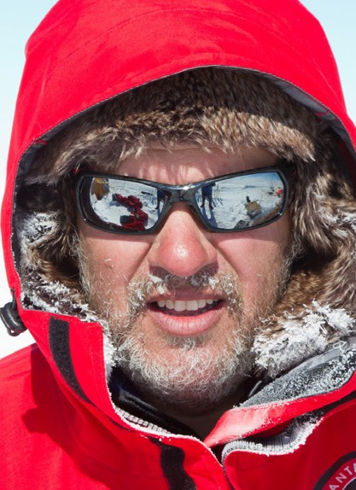
Project Leader. Ramon Larramendi. 1965. Is Spain biggest polar expeditions specialist. Has been involved in polar expeditions since 1985, when crossed interior of iceland with skis…
Member of the first Spanish expeditions across the Greenland ice cap in 1986, geographic north pole from Siberia in 1999 and magnetic north pole in 1998.
Leader of the Circumpolar Expedition. A 3 year and 14.000 km dogsled and kayak
expedition from Greenland to Alaska. Where he learned to speak Greenlandic language and the inuit way of travelling over the ice, dogsled travelling and inuit sled construction. Article published in National Geographic in January 1995.
Inventor of the WINDSLED in 1999, member and leader of all expeditions of the WINDSLED project.
2000, 2001, 2002, 2003. 4 succesful crossings of Greenland amounting to almost 6.000 km, including 2 south-north expeditions.
2005-6 Spanish Transantarctic expedition. First windpowered vehicle crossing of Antarctica. First to actual coordinates of inaccessibility south pole. 4.500 km in 62 days.
2011-12 ACCIONA WINDPOWERED
ANTARCTICA. 3.500 in 34 days. First windpowered vehicle to the south pole. Greenland Windsled Circumnavigation 2014. 4300km in 49 days.
Greenland summit windsled. 2016. Ascending by sail to icecap highest elevation. 2000km in 38 days.
Author of 3 books. Inuits. 1992, 3 years across the arctic, 1993. First sailing across Antarctica, 2011.
Speaks Spanish, French, English and Greenlandic.
Founder and Manager of Spanish travel agency VIAJES TIERRAS POLARES , and of TASERMIUT, South Greenland Expeditions in Greenland.

Slide 35
THE WINDSLED TEAM

Slide 36
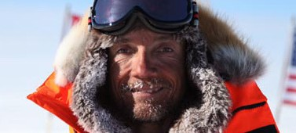
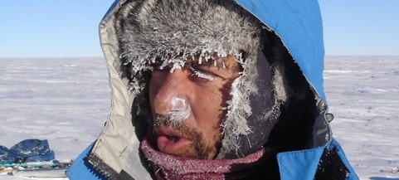
Ignacio Oficialdegui
Technical Director. Biologist.
Juanma Viu
Scientific and Logistic Director.
Pioneer in the development of wind energy projects worldwide at utility scale.
Currently, Director of Wind and PV Technology in ACCIONA Energy (Company World leader as pure player in renewable energy generation). With his team, he has been involved in the design of Wind and PV energy generation plants (utility scale) in 70 countries.
Master in Environmental Impact Assessment. International MBA in Sustainable Economy.
Medicus Mundi Navarra: Member of the Board 18 years; President 2 years. President of the Geographic Club of Navarra. Leader of the First Navarra Expedition to the North Pole in 2004.
Member of Spanish Transantarctic Expedition 2005-06.
Guide of "South Pole Without Limits” Expedition. A pioneer expedition of a team with Physical disabilities skiing to the South Pole. 2009
Logistic Director/Member of Acciona Windpowered Transantartic Expedition 2011-12
Windsled Team Leader in Greenland Ice Summit Expedition 2016.
Geologist. University of Zaragoza (Spain) and Univ of Abedeen U.K. MSc Enviromental Remote sensing. Univ Aberdeen. UK.
Airline Transport Pilot. For Iberia Airlines since 1997. Canadian ATPL validation for polar Operations. 2001. Extensive arctic travel. Canada, Greenland.
Member of the WINDSLED project since 2001, member of the 2003 Greenland crossing with WINDSLED.
Member of the Spanish Trans-Antarctic Expedition 2005-2006. Antarctic Station Leader at Spanish Scientific Base JUAN CARLOS I; 2008-2009 season.

Slide 37
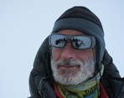
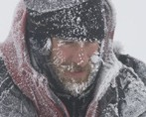
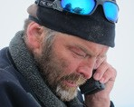
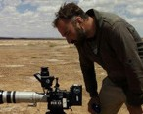
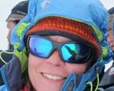
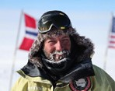
MANUEL OLIVERA - Spain. Mountain Climber. Civil Engineer. Member of Circumpolar Expedition 90-93. Greenland Windsled Circumnavigation 2014 and Greenland Summit Windsled 2016.
HILO MORENO - Spain. Mountain Guide. Works as guide in Spanish Antarctic base Juan Carlos I Member of Greenland Summit Windsled 2016.
HUGO SVENSSON - Greenland. Extensive polar Experience. Member of Greenland Windsled Circumnavigation 2014.
NACHO GARCÍA - Spain. Camera, photographer. Director of Production company. The Beagle Production. Member of Greenland Summit Windsled 2016.
KARIN MOE BOJSEN - Denmark. Mountain climber, Civil Engineer. Greenland Windsled Circumnavigation 2014 and Greenland Summit Windsled 2016.
JAVIER SELVA - Spain. Photographer. Mountain climber. Member of Acciona Windpower Antarctica 2011-12.
* The definitive composition of the expedition is not yet determined, but the 7 members will come among those people, all with experience in previous windsled expeditions.

Slide 38
